Slide 1
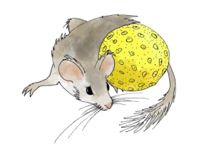



The Neotoma Paleoecology Database
(www.neotomadb.org)
Eric C. Grimm
University of Minnesota
Geoinformatics Program

Slide 2
Q: What is Neotoma?
A: An Open-Access Multiproxy Community Database for the Quaternary-Pliocene

Slide 3
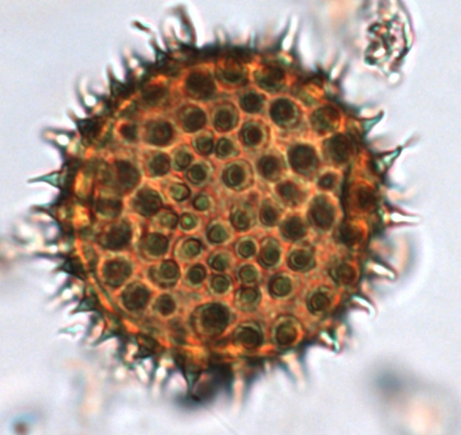
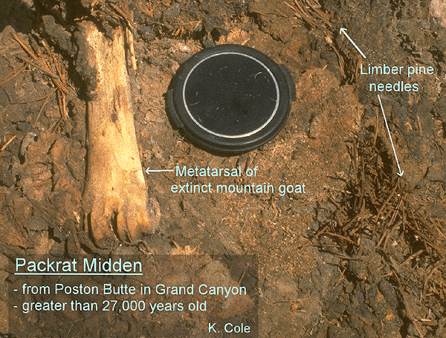
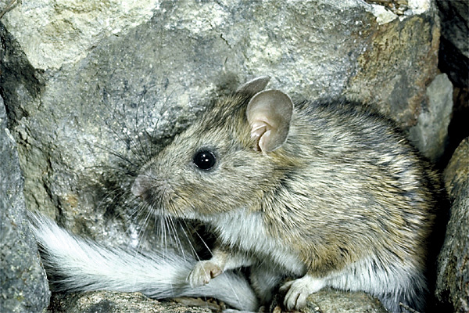
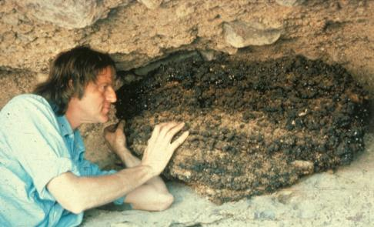
Q: Whence Neotoma?
A: Named for the packrat (Neotoma), a multiproxy data collector.

Slide 4
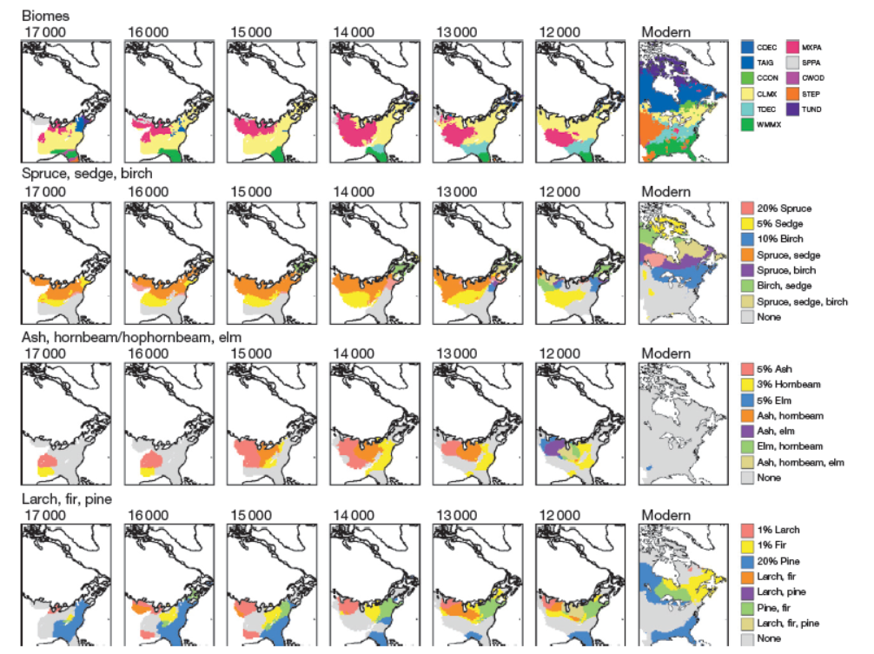
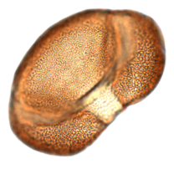
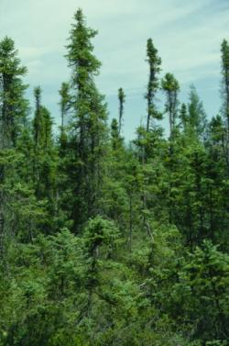
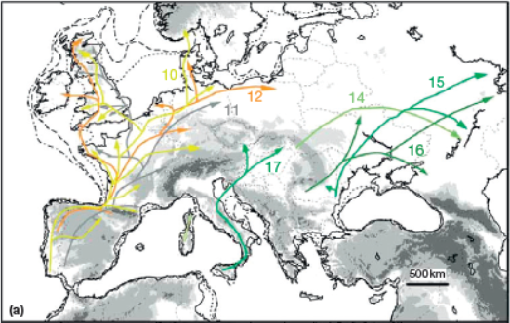
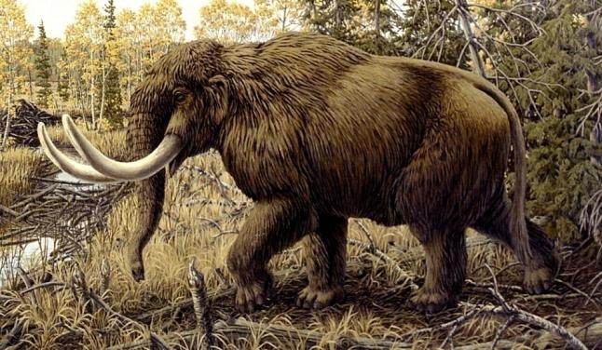
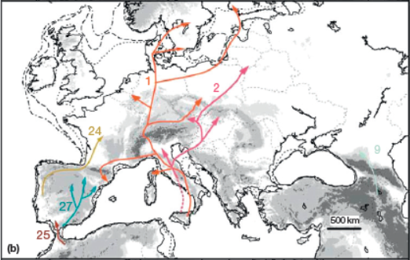
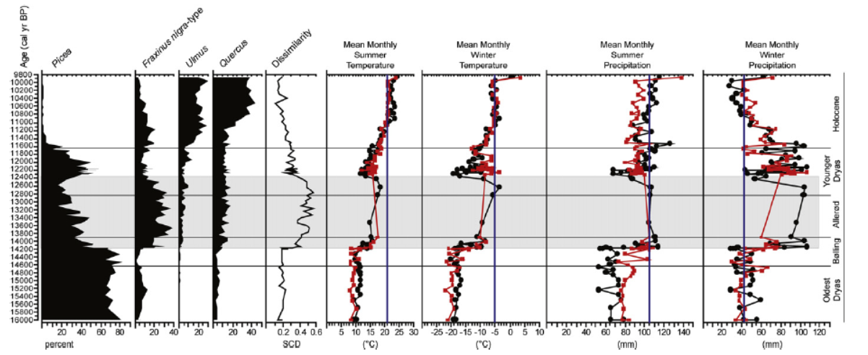
Purposes of Neotoma
To facilitate studies of ecosystem development and response to climate change
To enable joint analysis of multiproxy datasets to address paleoenvironmental questions that transcend those possible with single-proxy databases.
To provide the historical context for understanding biodiversity dynamics, including genetic diversity
To provide the data for climate-model validation
To facilitate analyses of biostratigraphy
To provide a safe, long-term, low-cost archive for a wide variety of paleobiological data
To lower the overall cost of paleodata management
To meet data management, data sharing, and archival requirements of funding agencies, institutions, and journals.
inferred postglacial colonization routes for frequent cpDNA haplotypes of deciduous Quercus. (Petit et al. 2002)
Representations of late Pleistocene and modern plant associations as biomes (top row) and as multitaxon isopoll maps (rows 2–4). Williams et al. (2001)
Gonzales et al. (2009)

Slide 5
Neotoma Design Concepts
Partnership between domain scientists and information technology specialists; wherein the science is driving the IT.
Neotoma offers database infrastructure to specialists in various taxonomic groups, who will not need to develop or even necessarily understand the core information technology, but who can learn to input, update, and extract data through a user-friendly interface and to have control over disciplinary taxonomic issues.
Neotoma can accommodate virtually any type of fossil data
Neotoma is a centralized database with virtual constituent databases (e.g. North American Pollen Database, FAUNMAP)
Capability for “data stewards” to remotely input and update data
Neotoma is a curated database, not just a data archive
Access to the data by anyone with an Internet connection

Slide 6
Neotoma Data Policies
Although Neotoma data are, in general, open access, data users are expected to abide by rules for attribution, citation, and co-authorship.
Data Use Policy
Embargo Policy
Contribution of new and unpublished datasets to Neotoma prior to first publication
Preparation and uploading of previously published datasets to Neotoma by data synthesizers

Slide 7
Neotoma Constituent Databases
Academy of Natural Sciences of Drexel University (Diatoms)
African Pollen Database
Alaskan Archaeofaunas
ANTIGUA
Canadian Pollen Database
Chinese Pollen Database
European Pollen Database
FAUNMAP
French Institute of Pondicherry Palynology and Paleoecology Database
Holocene Perspective on Peatland Biogeochemistry
Neotoma
North American Non-Marine Ostracode Database Project (NANODe)
Indo-Pacific Pollen Database
Japanese Pollen Database
Latin American Pollen Database
MioMap
Neotoma Midden Database
North American Plant Macrofossil Database
North American Pollen Database
North Dakota State University Insect Database
Pollen Database for Siberia and the Russian Far East

Slide 8


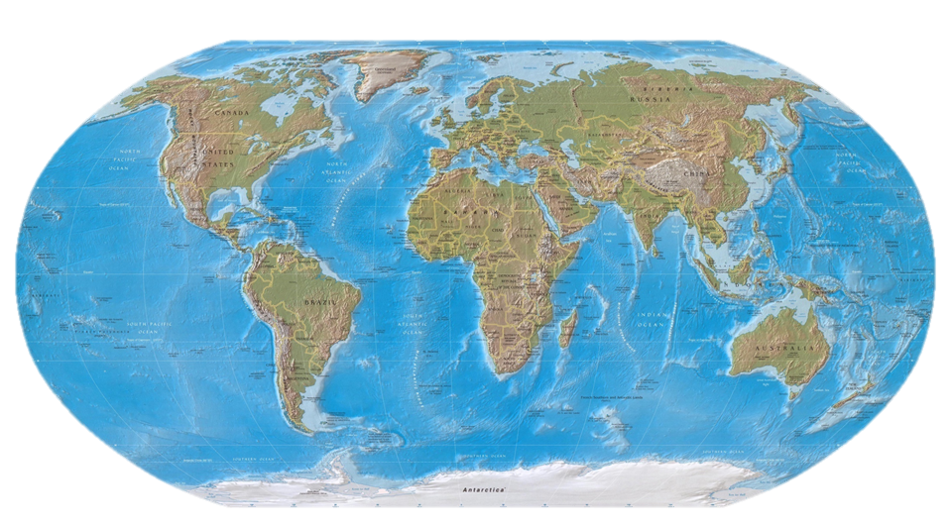
NEOTOMA: Data Stewards
Center for Environmental Informatics, Pennsylvania State University

Slide 9
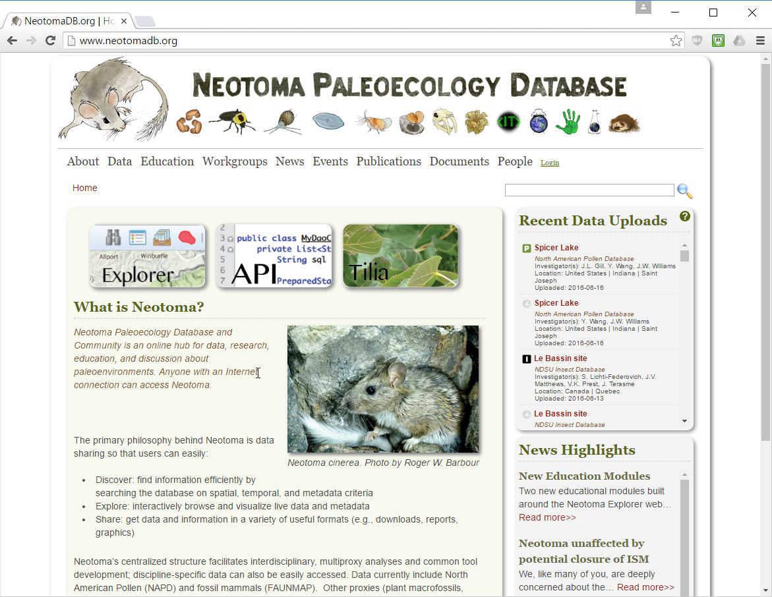
NEOTOMA Website: www.neotomadb.org

Slide 10
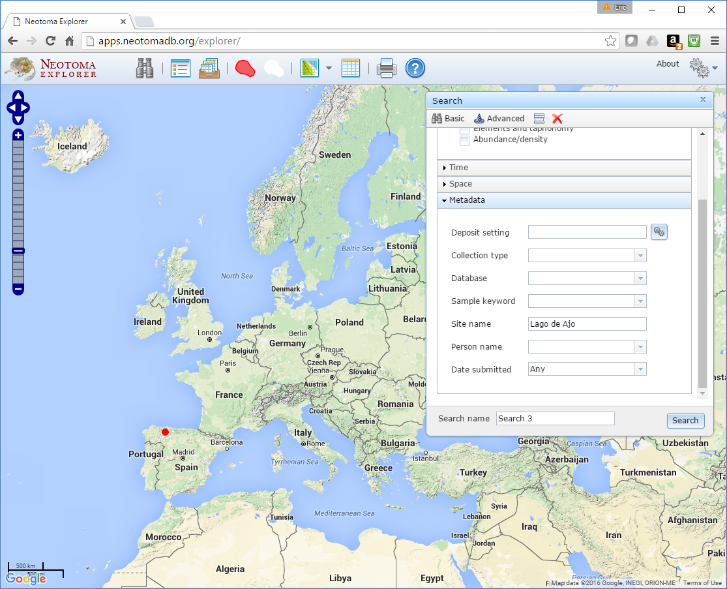
NEOTOMA Explorer

Slide 11
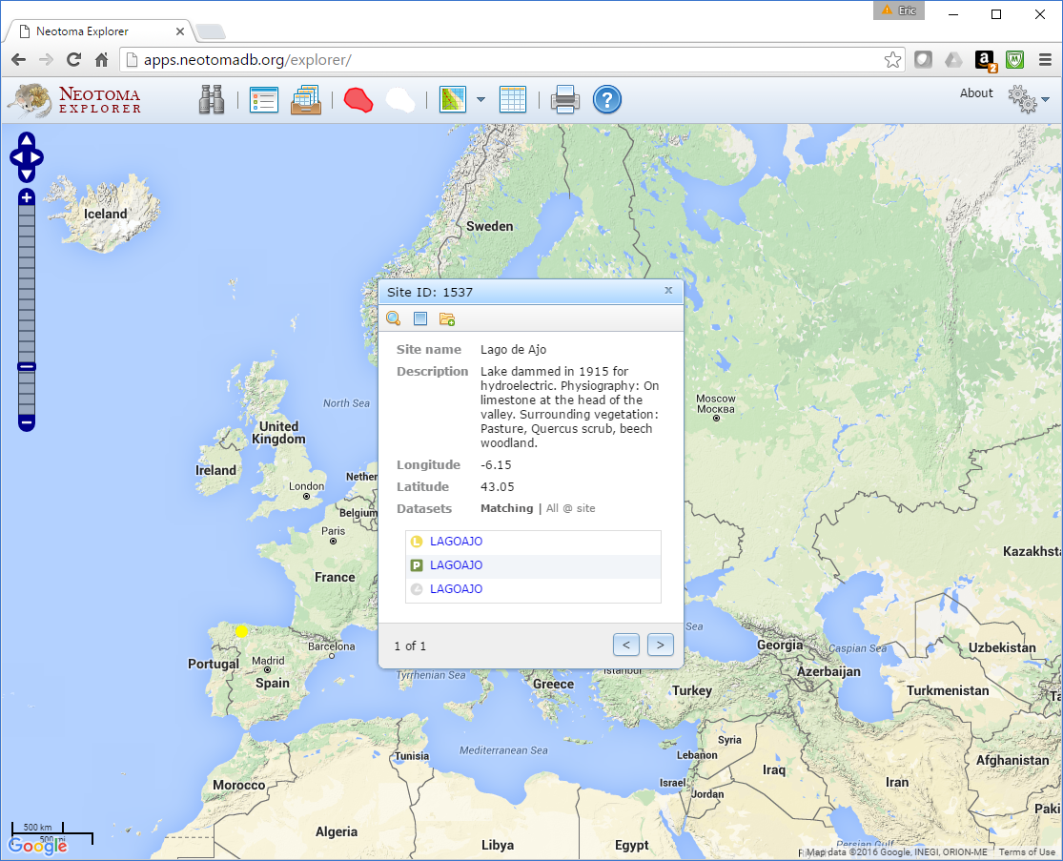
NEOTOMA Explorer

Slide 12
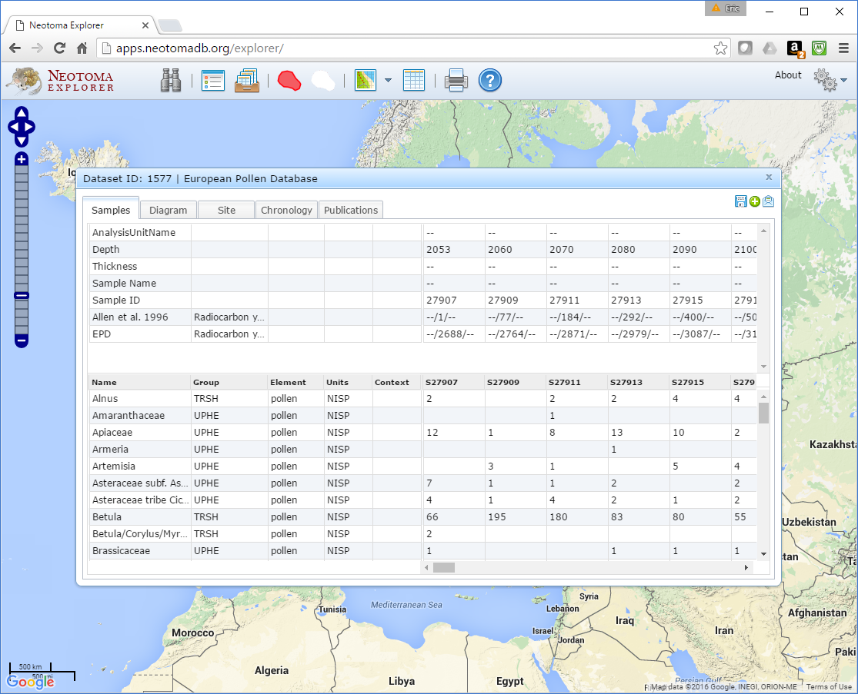
NEOTOMA Explorer

Slide 13
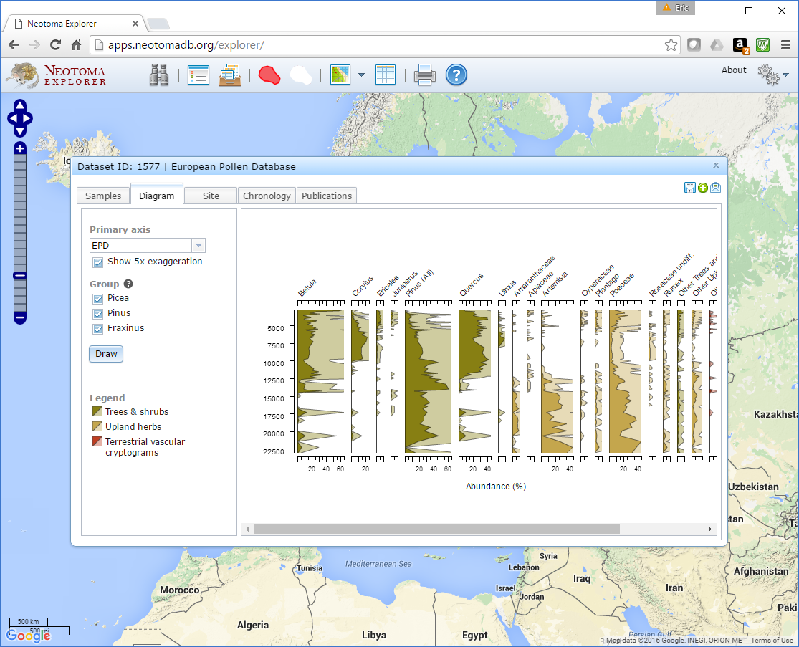
NEOTOMA Explorer

Slide 14
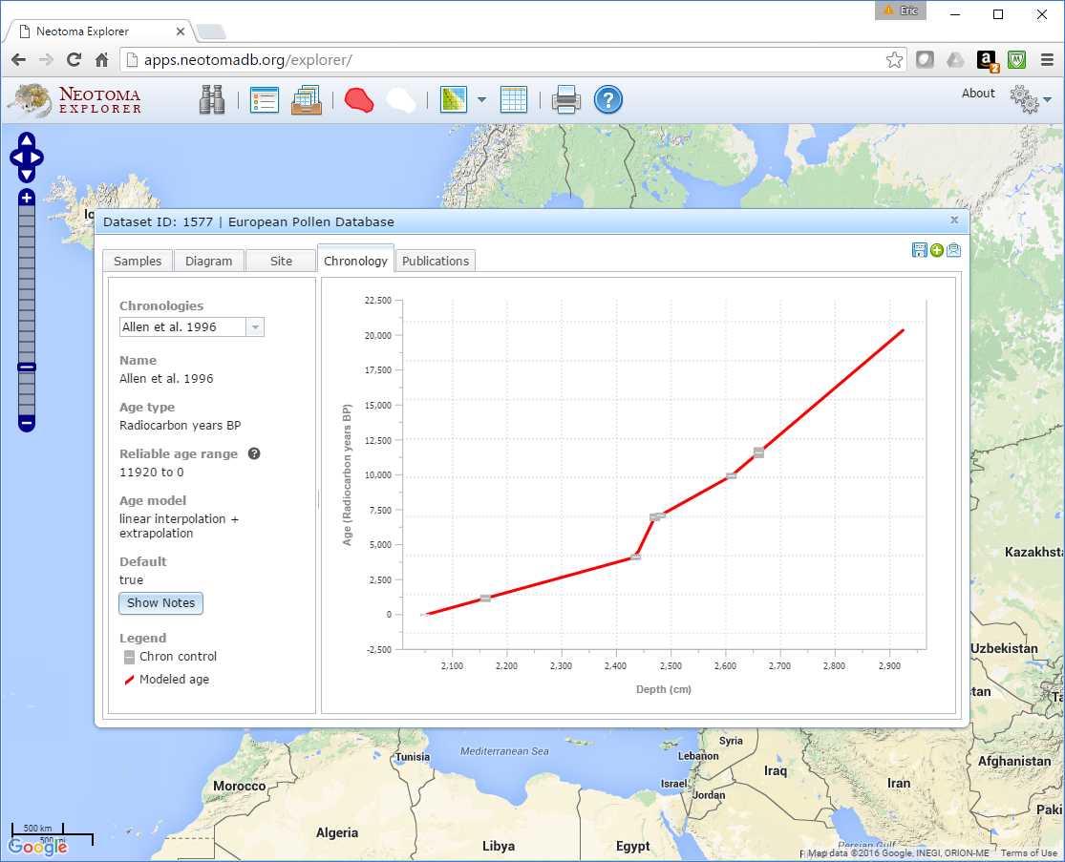
NEOTOMA Explorer

Slide 15
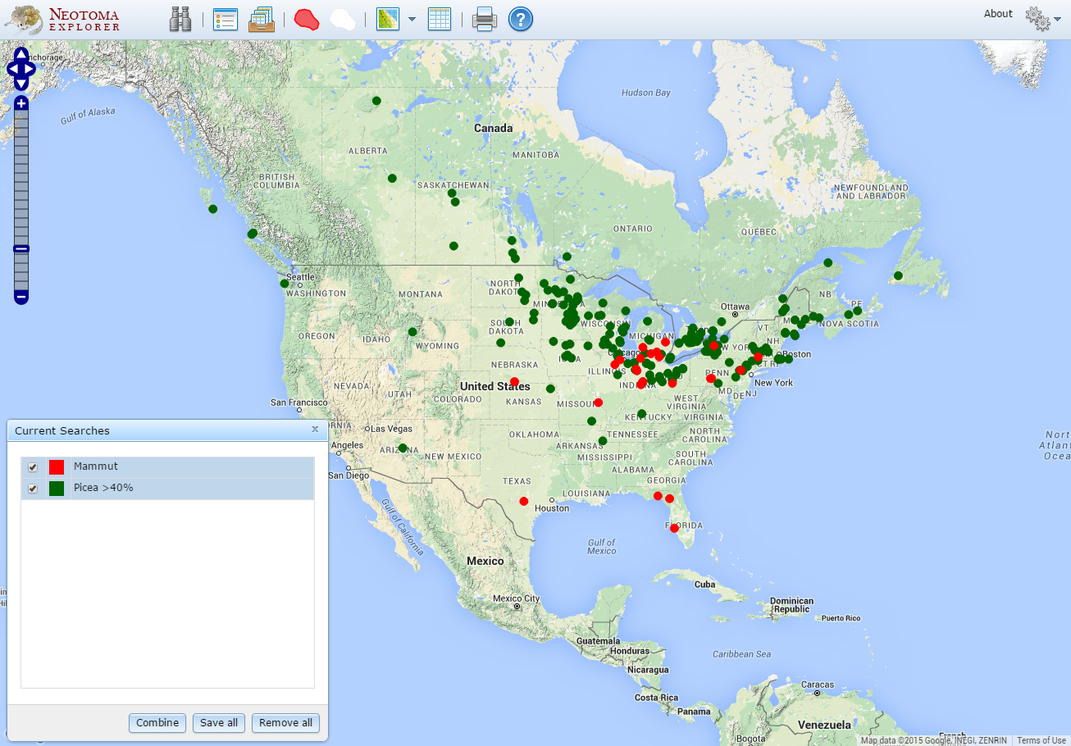
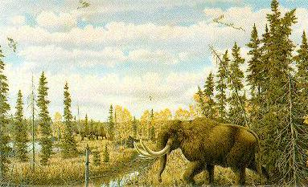
18-12 ka: >40% Picea, Mammut

Slide 16
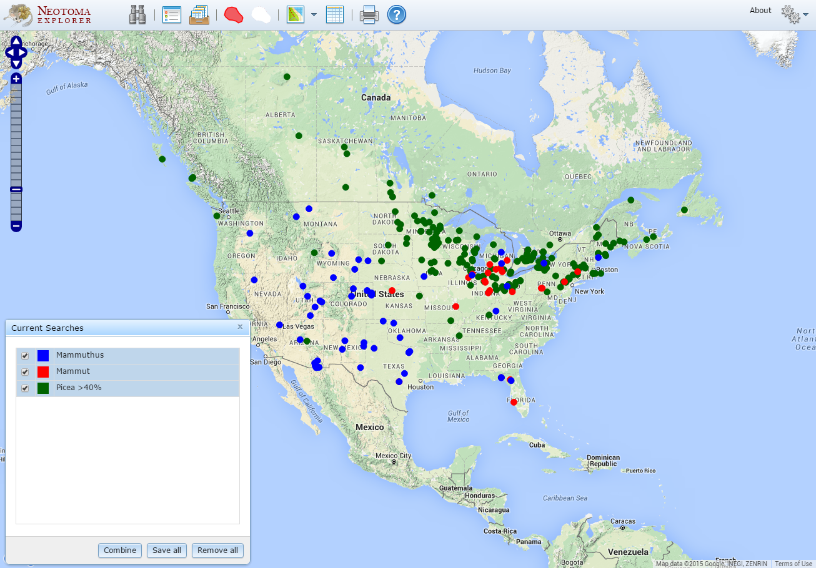
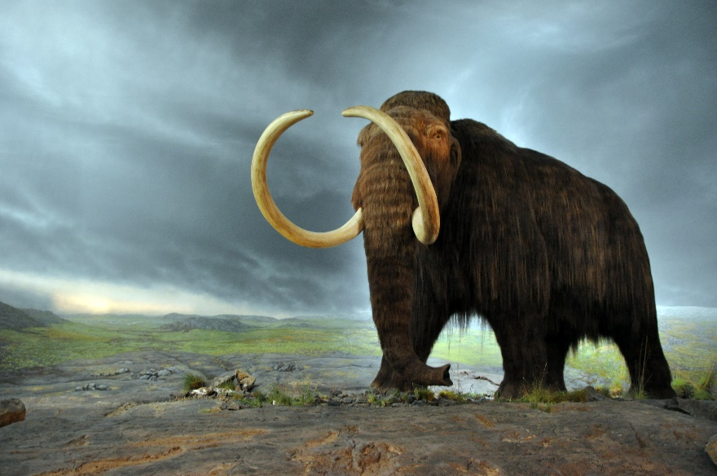
18-12 ka: >40% Picea, Mammut, Mammuthus
Critical issue is dating!

Slide 17
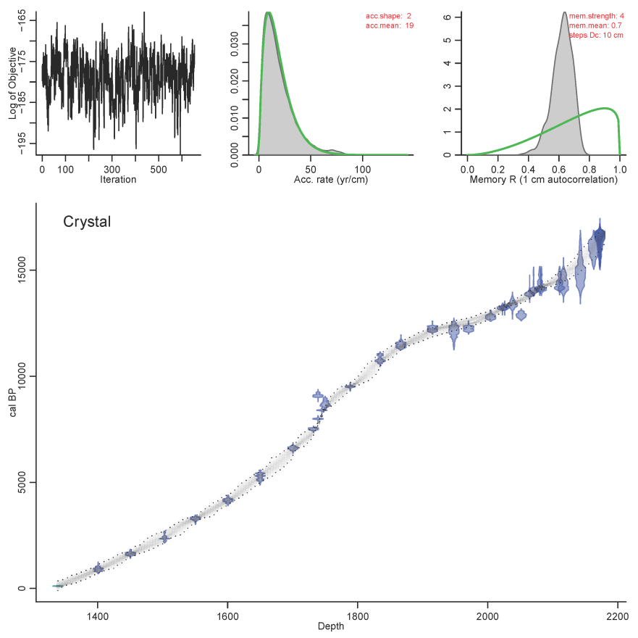
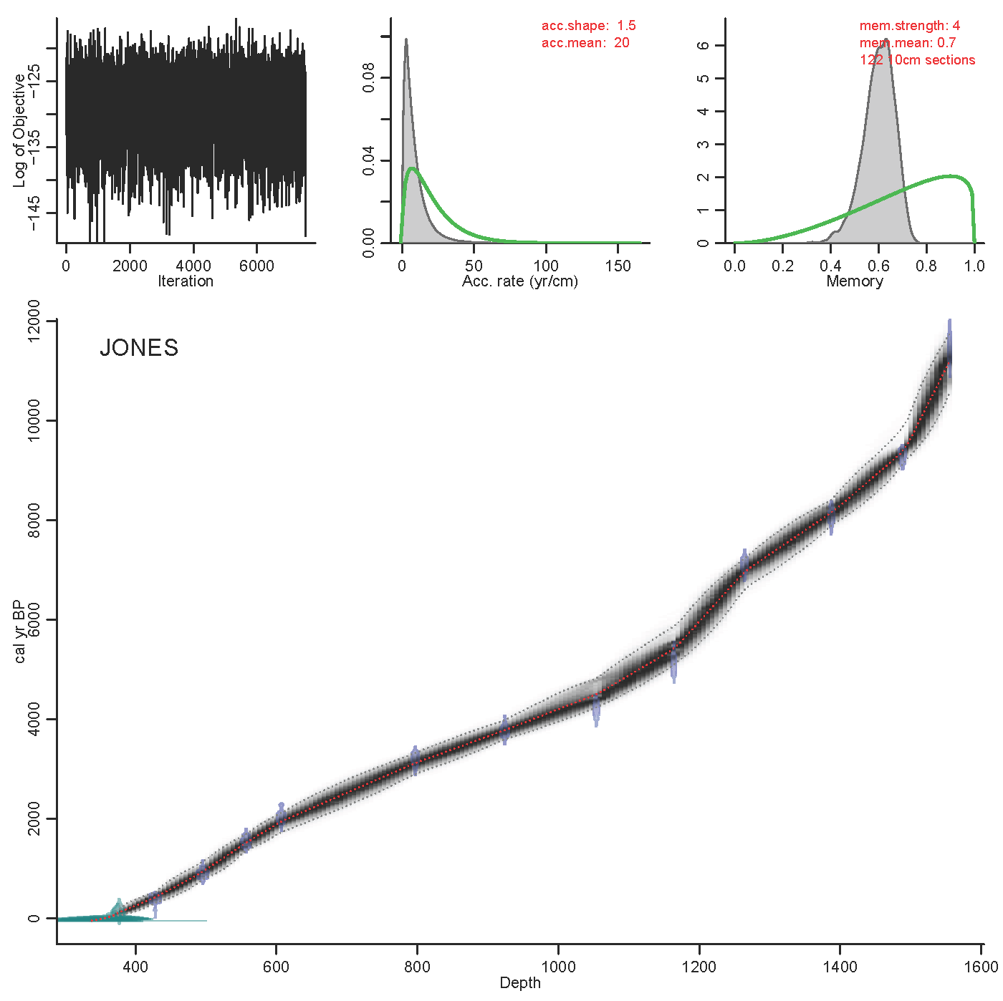
Value Added: Chronologies and Age Models

Slide 18
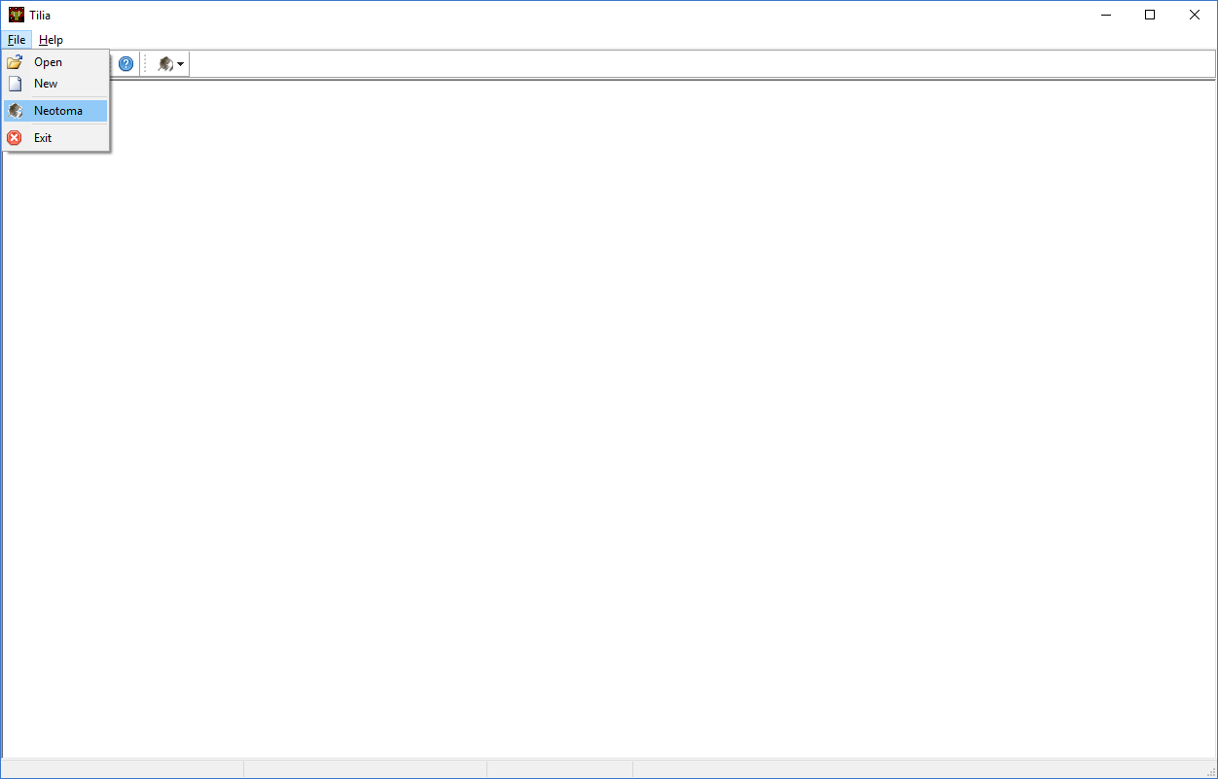
Tilia

Slide 19
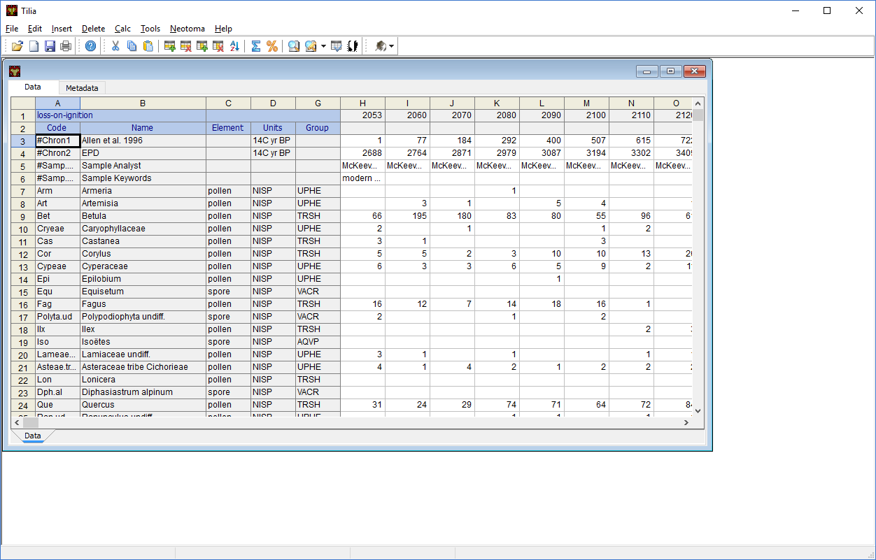
Tilia

Slide 20
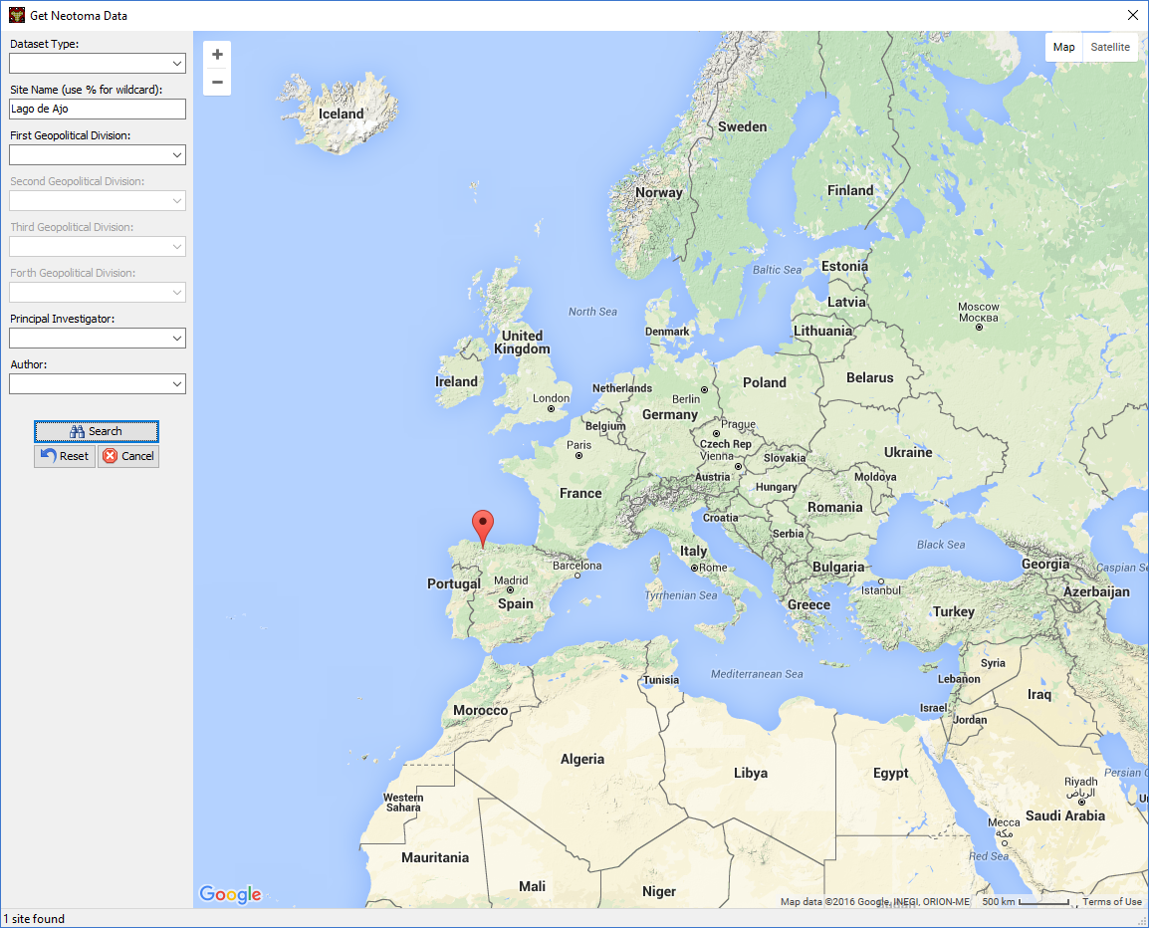
Tilia

Slide 21
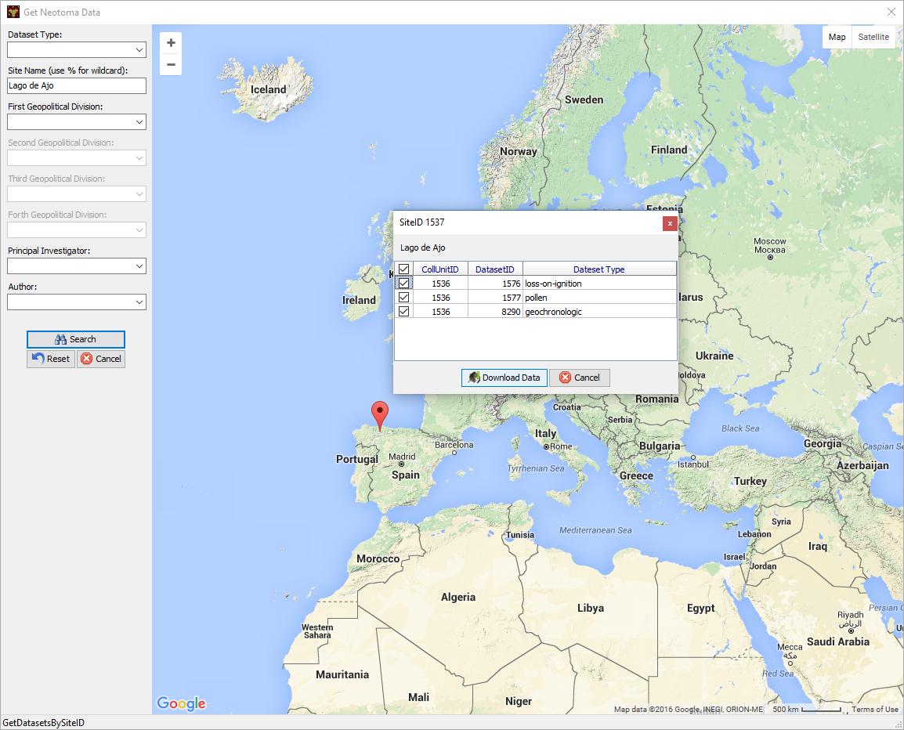
Tilia

Slide 22
Neotoma Application Programming Interface (API)

Slide 23
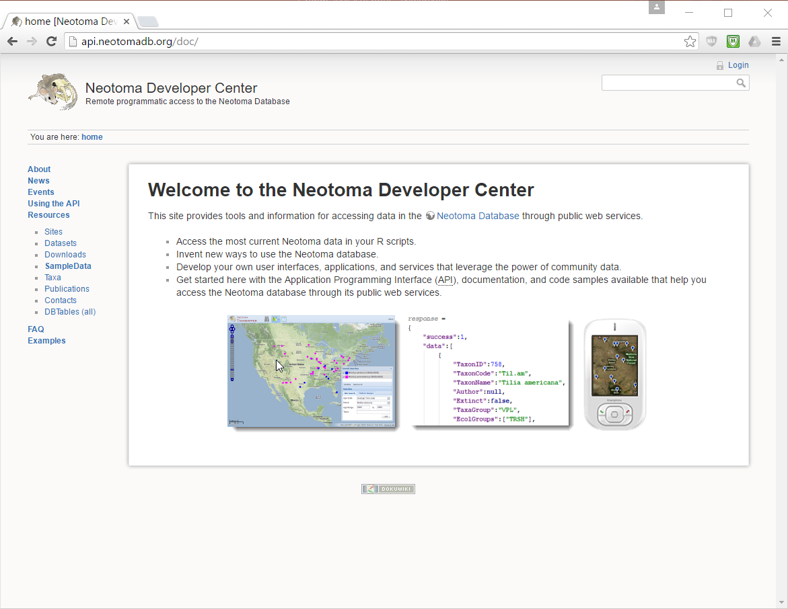
Neotoma Application Programming Interface (API)

Slide 24
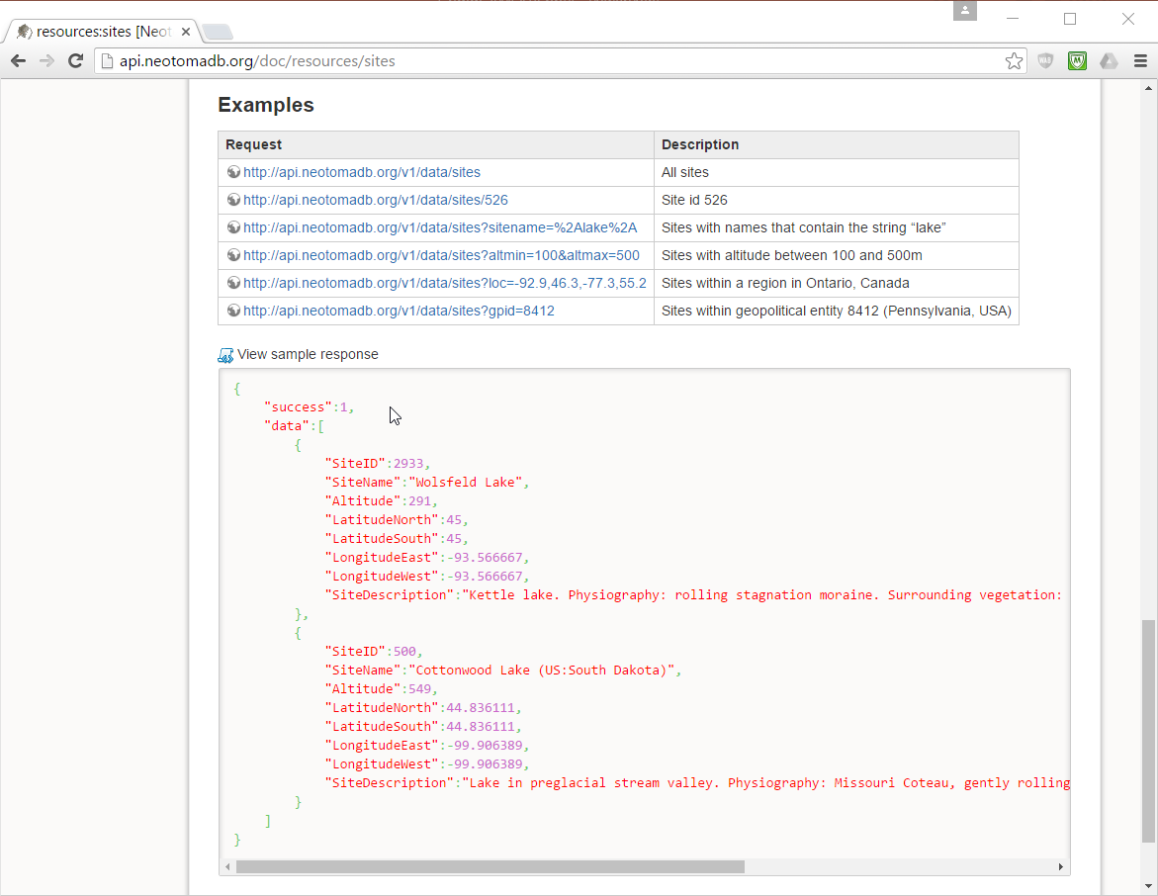
Neotoma Application Programming Interface (API)

Slide 25
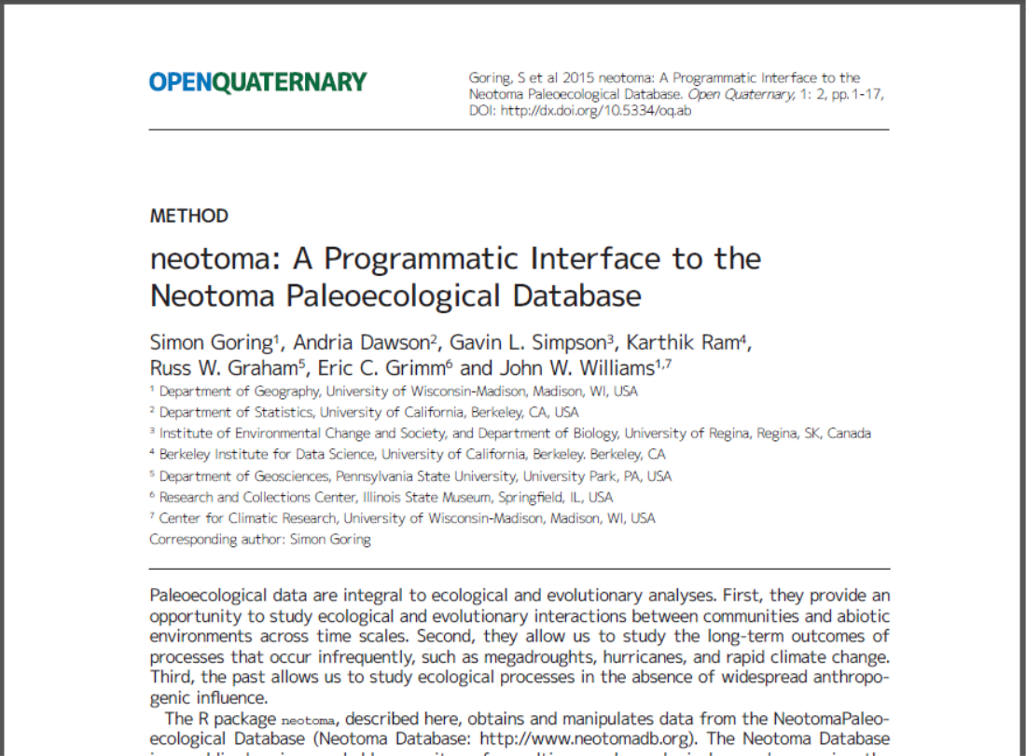
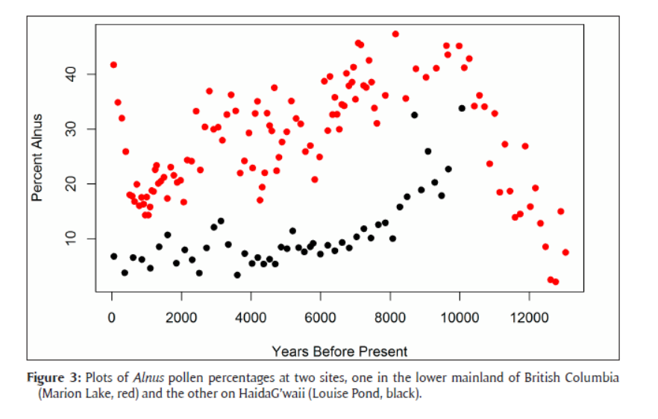
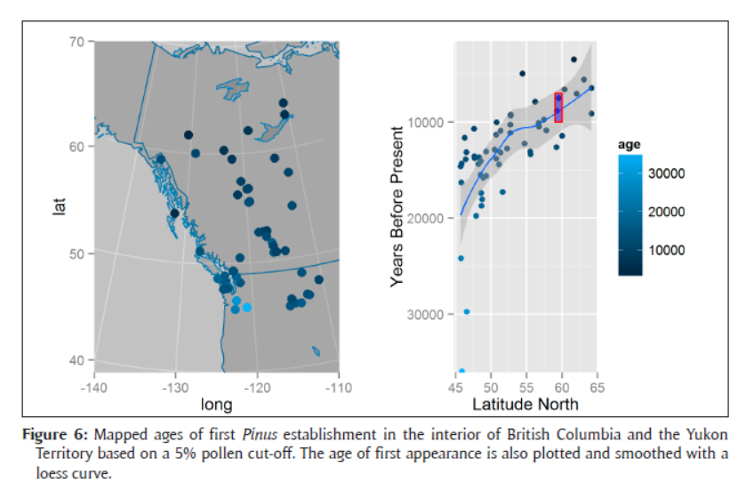
neotoma R package

Slide 26
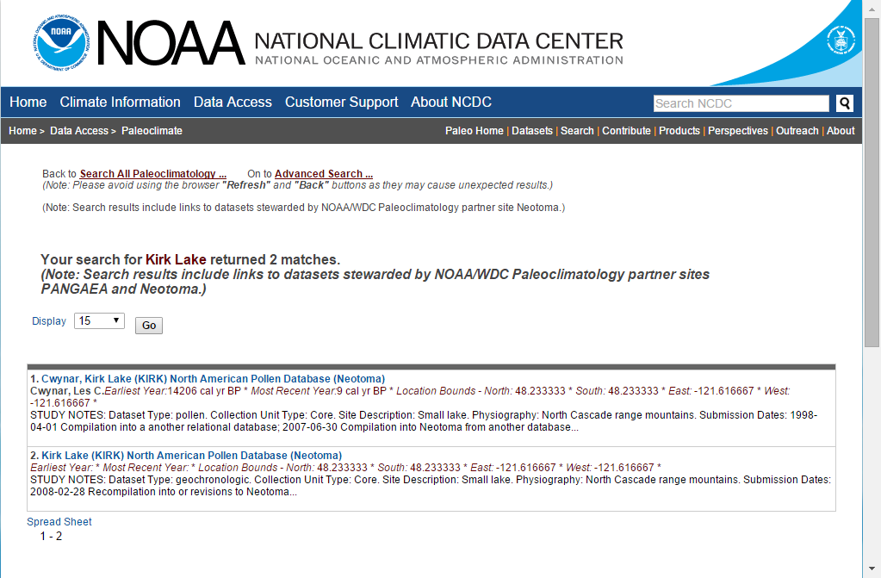
Neotoma Application Programming Interface (API)

Slide 27
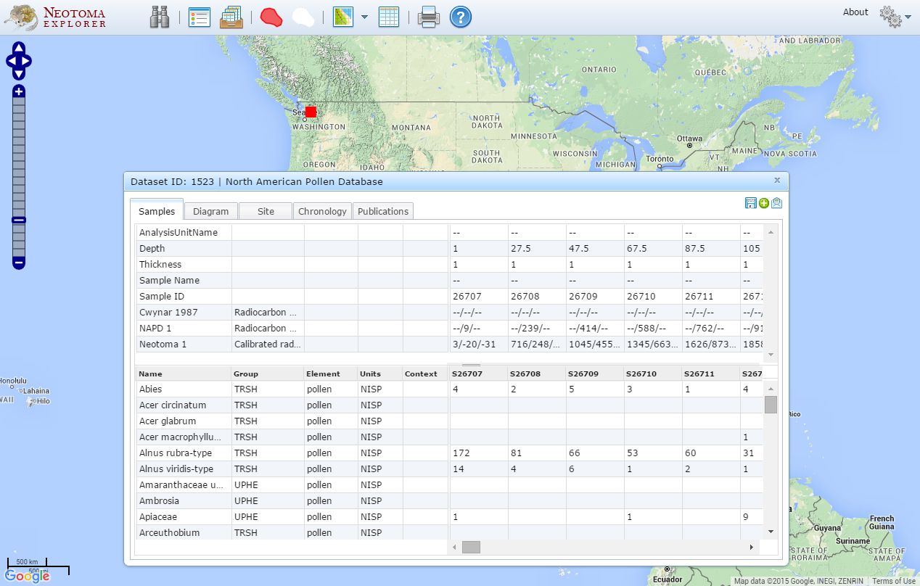
Neotoma Application Programming Interface (API)
http://apps.neotomadb.org/Explorer/?datasetid=1523

Slide 28
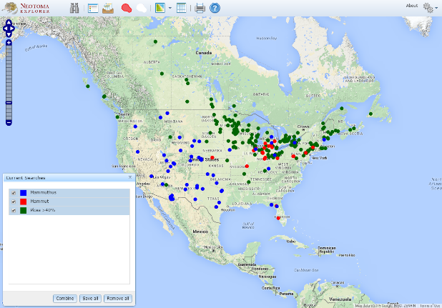
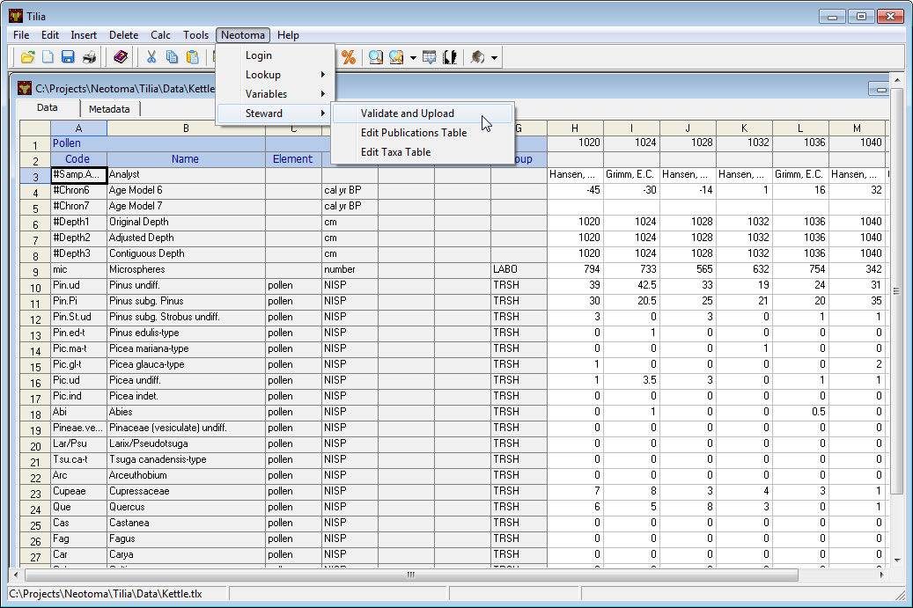
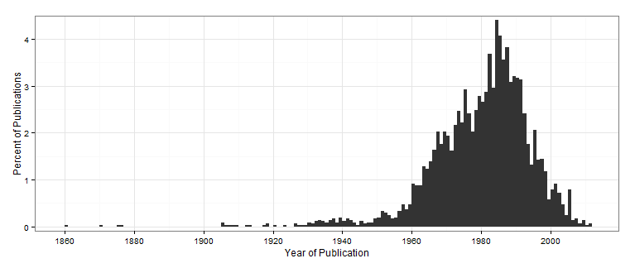
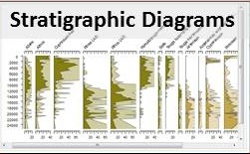
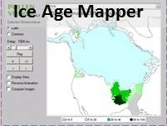
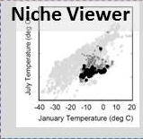
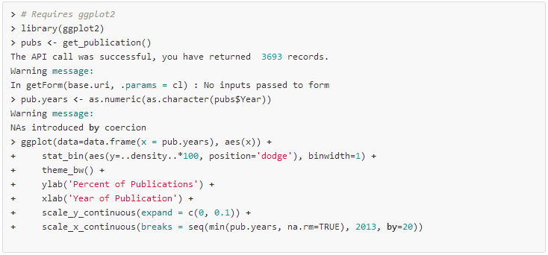
Neotoma Informatics Ecosystem
Data Exploration and Retrieval
Data Upload and Download
Neotoma Explorer
Tilia
API
Web Services
Neotoma
DB
Data Retrieval and Analysis
neotoma package for R
Data Visualization

Slide 29
New Initiatives
Expanding to accommodate other data types: isotopes, biomarkers,…
Accommodating specimen level data
Forging links with other databases: NOAA Paleo, Paleobiology Database, GBIF,…
Issuance of DOI’s
Establishment of embargo capability
Workshops: EPD, Linked Earth - LiPD, C4P Hackathon, AmQua, ESA, SVP, IBS

Slide 30
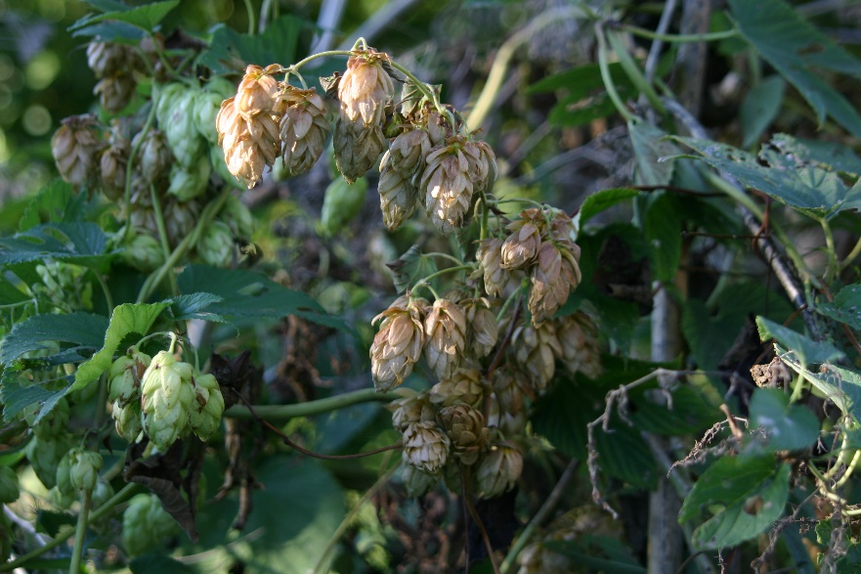
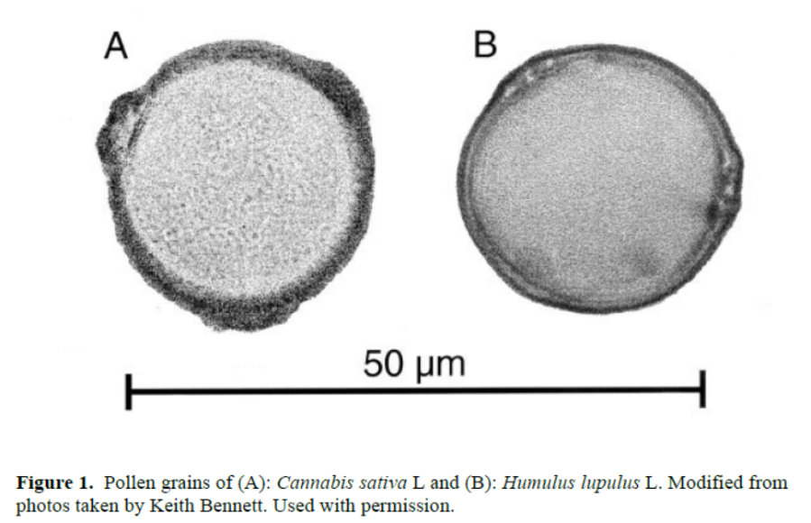
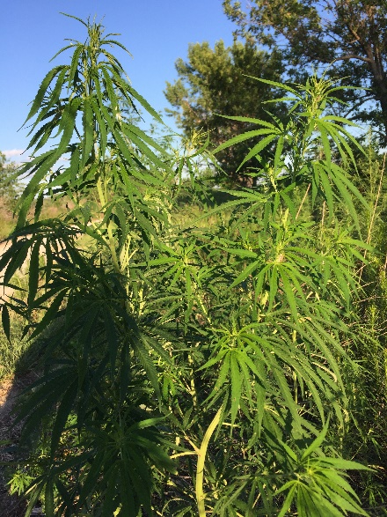
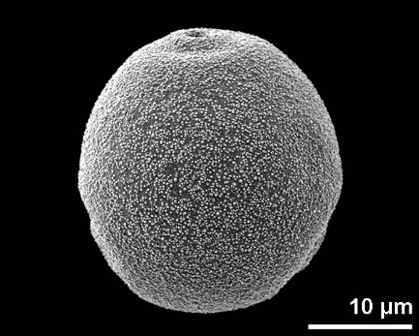
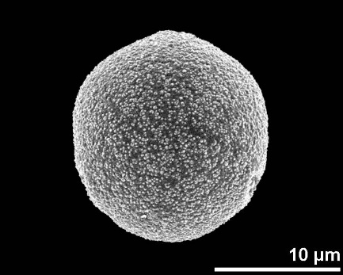
Taxonomy
Good database design entails using controlled vocabularies insofar as possible.
Taxonomy is a challenge because taxonomic concepts change through time.
Cannabis
Humulus
Cannabaceae
Cannabis/Humulus
or Cannabaceae

Slide 31
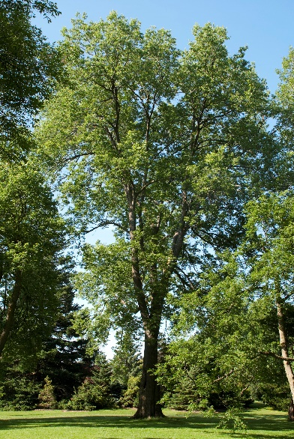
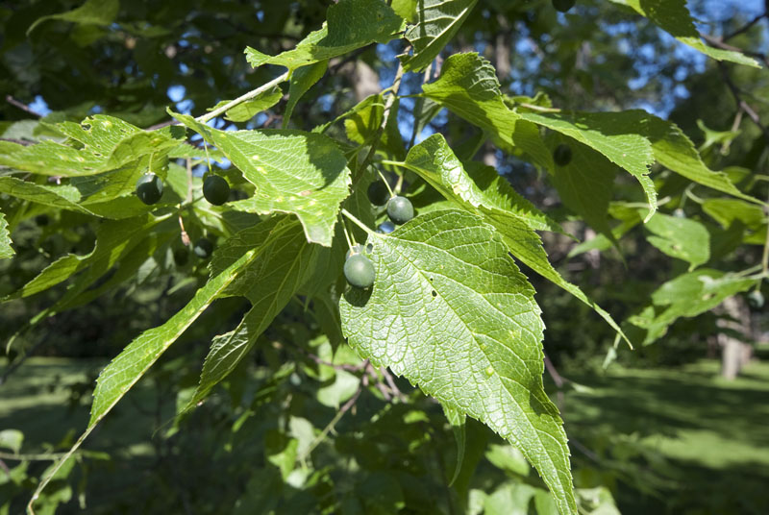


Taxonomy
Good database design entails using controlled vocabularies insofar as possible.
Taxonomy is a challenge because taxonomic concepts change through time.
Cannabis
Humulus
Celtis
Cannabaceae
Ulmaceae

Slide 32



Taxonomy
Bayesian tree based on the combined data of four chloroplast genes.
Good database design entails using controlled vocabularies insofar as possible.
Taxonomy is a challenge because taxonomic concepts change through time.
Triporate pollen is inferred to be the ancestral state for Cannabaceae in both the parsimony and Bayesian analyses with a relatively high probability (85.8%; Fig. 2C).

Slide 33
Taxonomy
Good database design entails using controlled vocabularies insofar as possible.
Taxonomy is a challenge because taxonomic concepts change through time.
Cannabis
Humulus
Celtis
Cannabaceae
Ulmaceae
Cannabaceae
Cannabis/Humulus

Slide 34
www.neotomadb.org
Thank you!

